Slide 1



“Google” Home Page Project

Slide 2



Contents of this presentation:
This project is designed for learning and applying the gained knowledge of Database Management System and Web designing in creating a lookalike of already existing “GOOGLE Home page” consisting of Google logo, search icons, text box, Gmail, images buttons etc using HTML, CSS, JavaScript and connecting the web page to Database to store User Information.

Slide 3

Introduction
In this project we aim to design “GOOGLE Home page” lookalike and connect it to database system to store user information. Our web page work as search engine so that user would be able search relative web pages or search URLs for their respective queries.

Slide 4
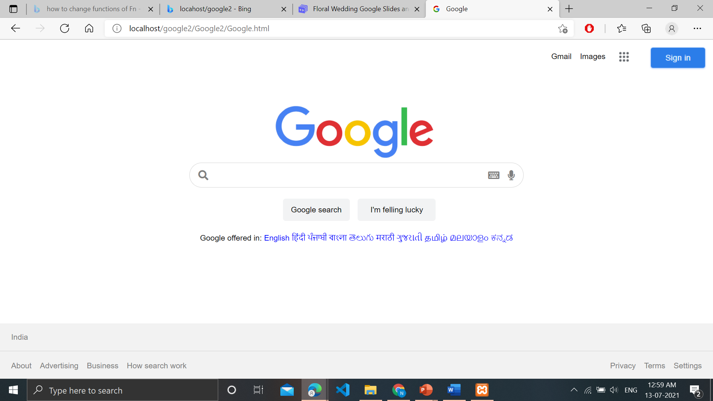
Home Page
The essence idea of the Home page is to put user’s needs first and thus we have added a lot of links making it both user friendly and eye catching.

Slide 5


01
02
Navigation Bar
Search Bar
03
04
Database
Footer
Helps to User to navigate to important features of website
The text Box where user can search their query
Structure of Home Page
The User’s information is stored at the admin side in the database in a tabular format
To help User find settings, Terms and conditions, and other related quick links to contact.

Slide 6
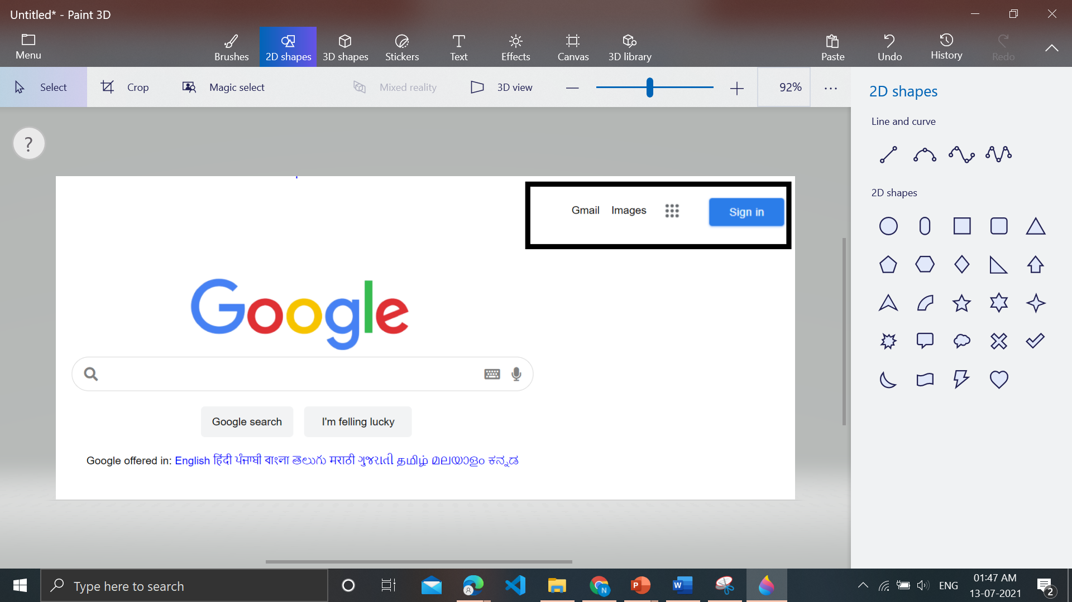
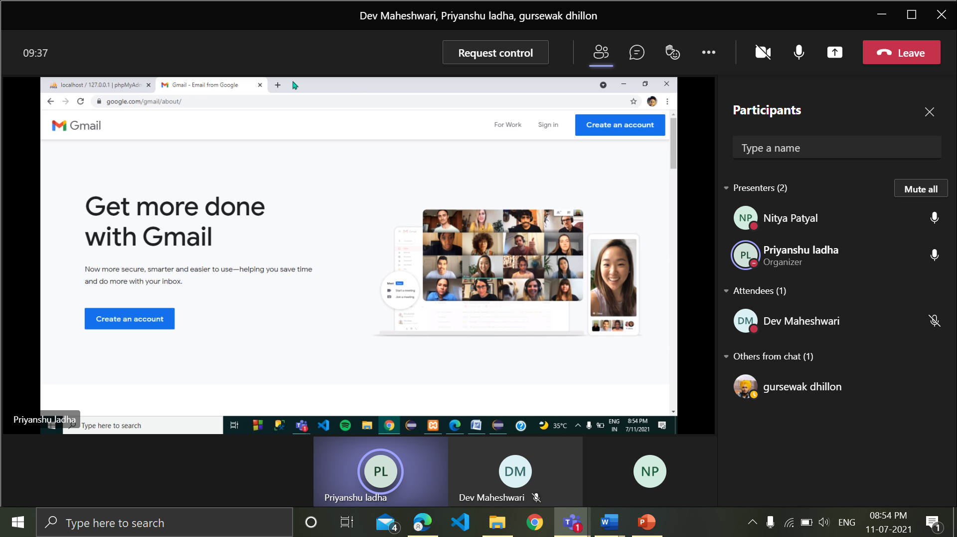
01
Navigation Bar
Navigation Bar
Images
Apps
Sign Up
Gmail

Slide 7
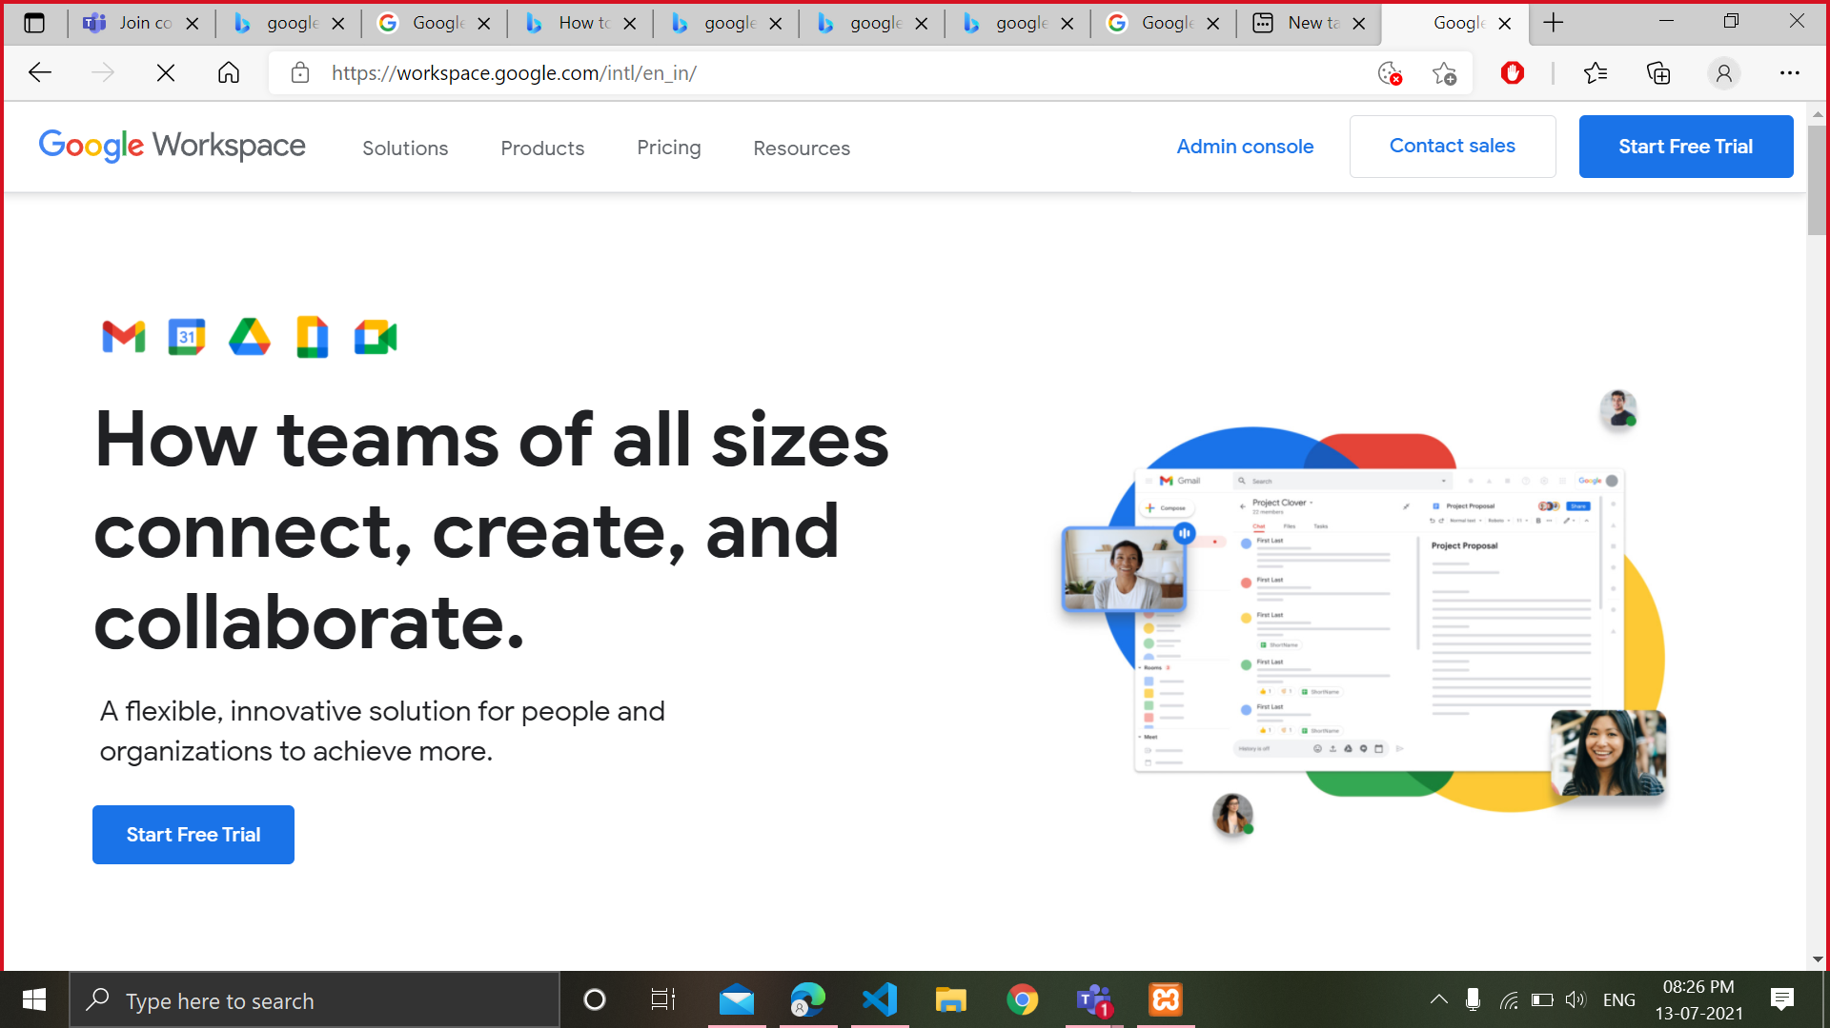

Google Apps
Easy access to related content

Slide 8
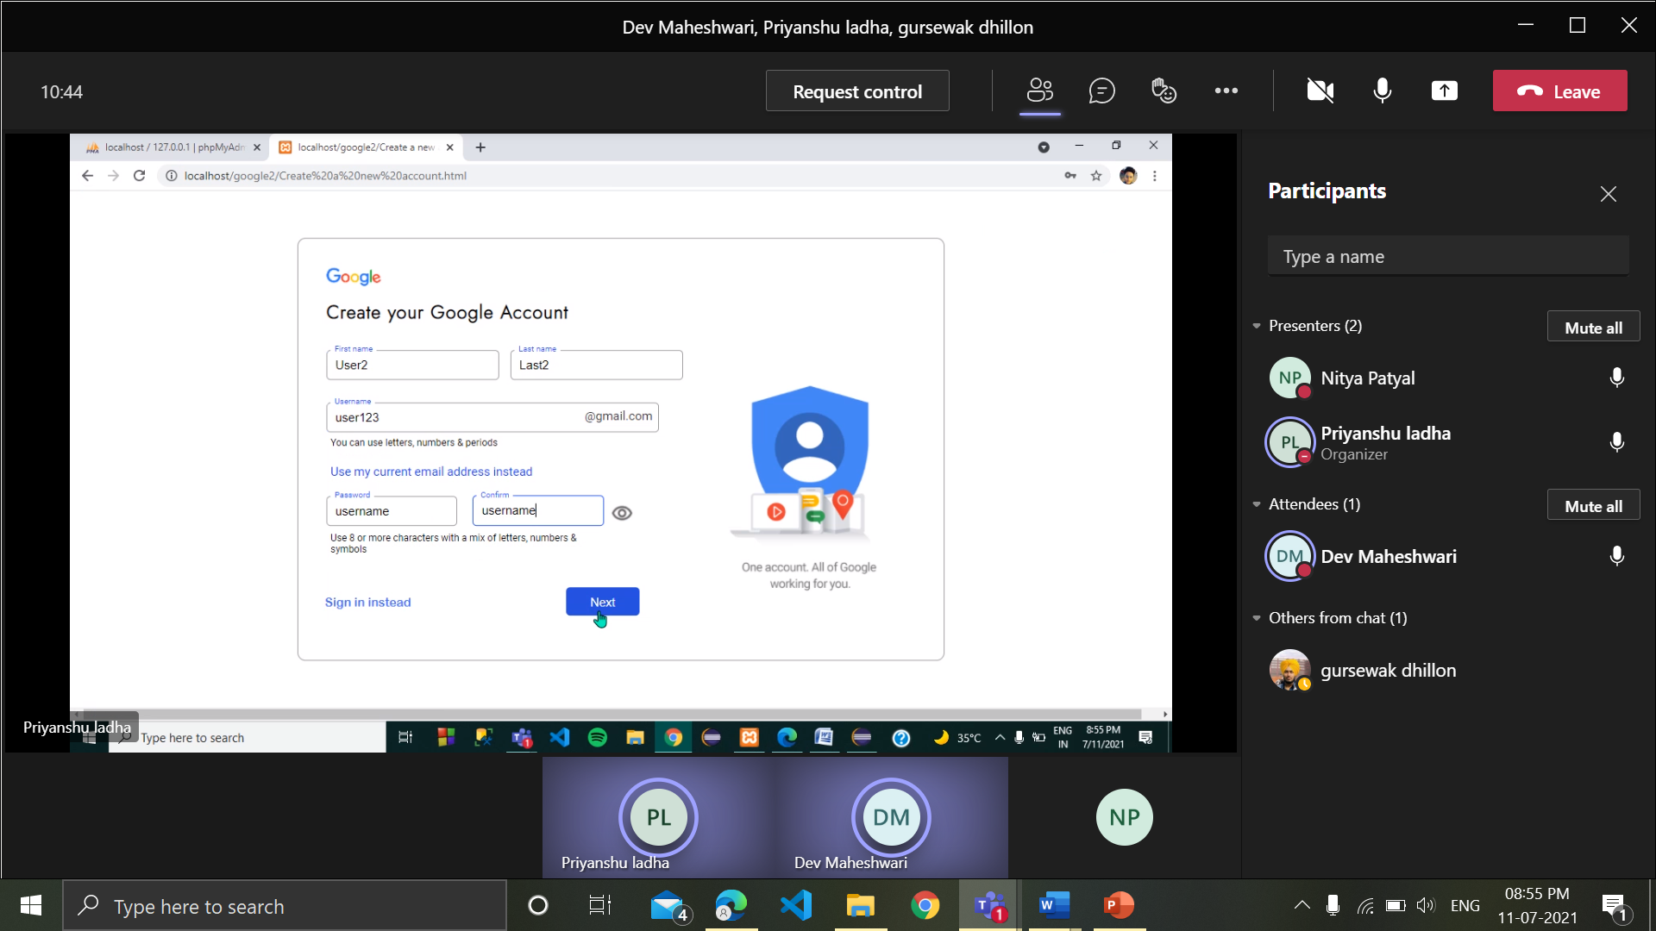
Sign in Page
This User personal info will be stored in in the database.

Slide 9

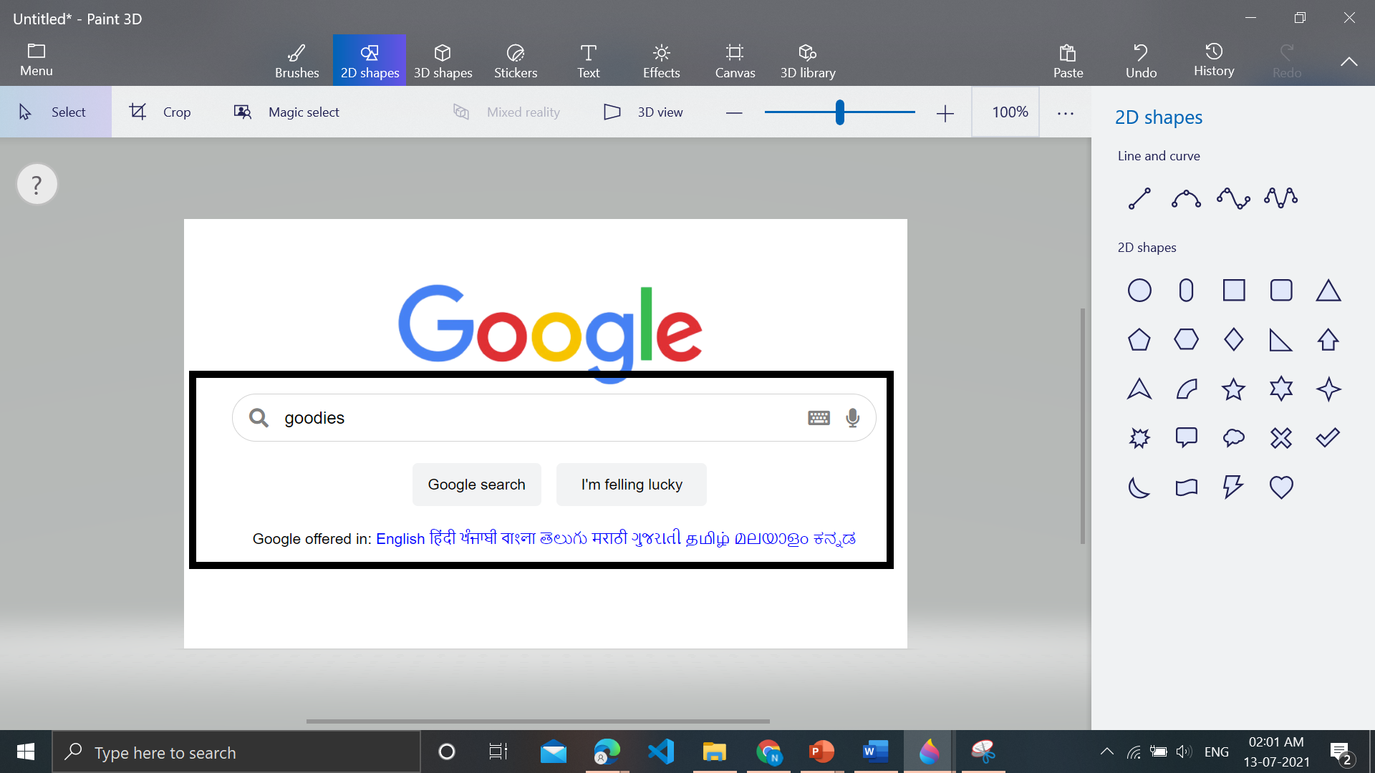
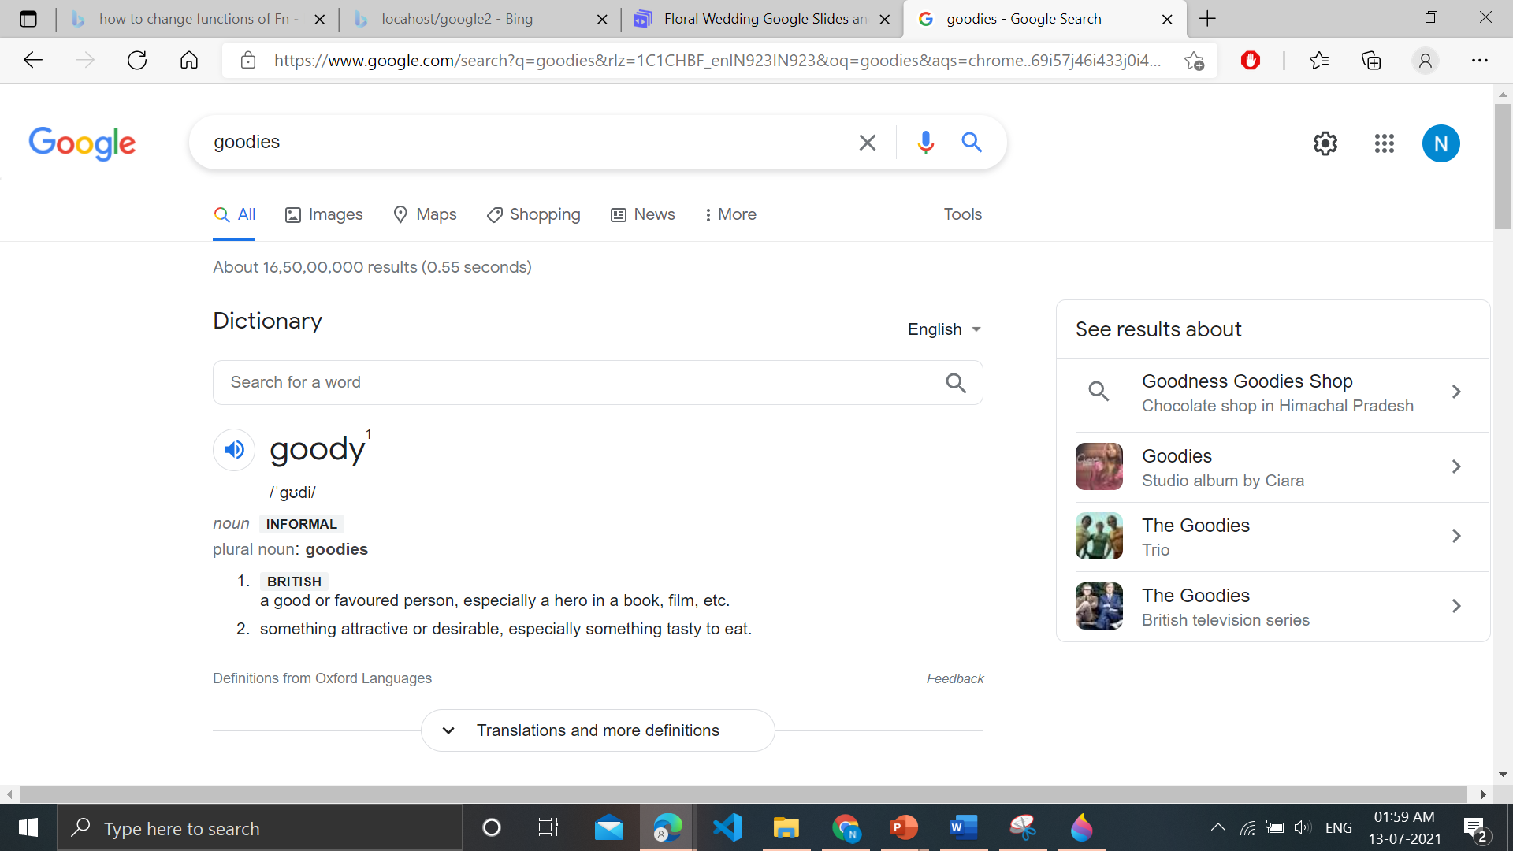
Our search

Slide 10
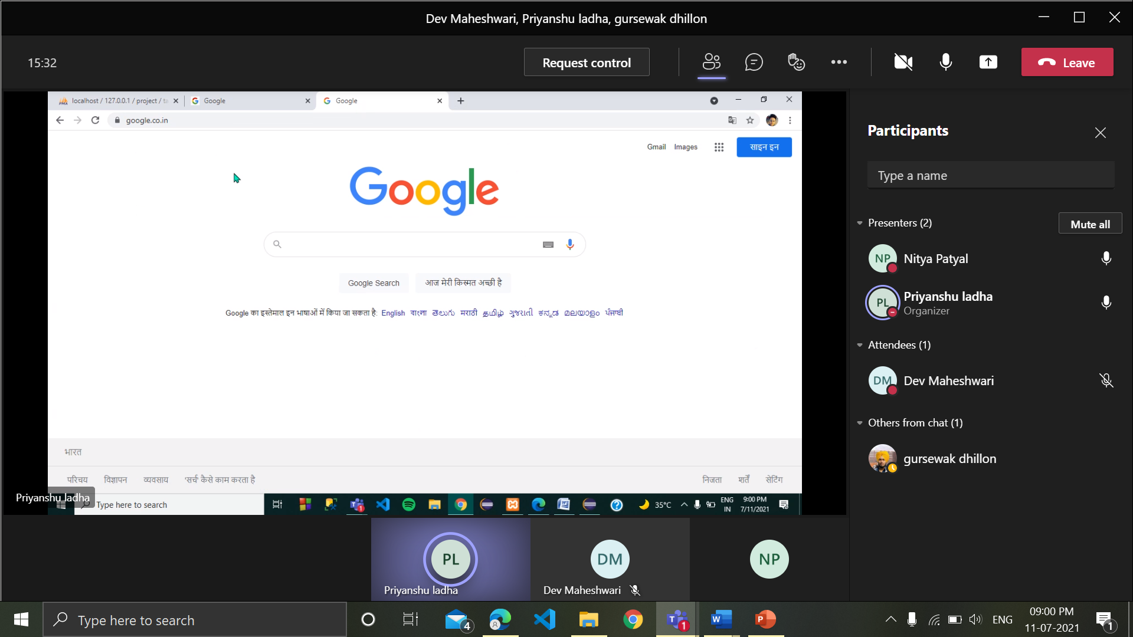
Eradicating all languages Barrier

Slide 11
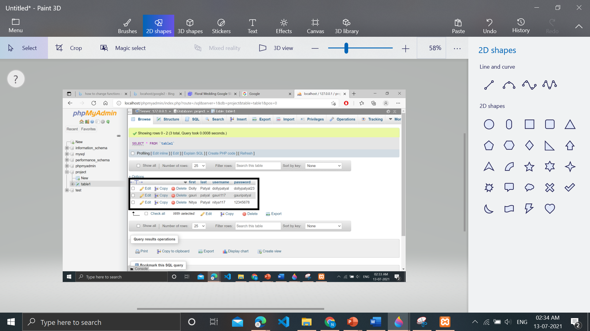

03
Database
It contains Users sign up info

Slide 12
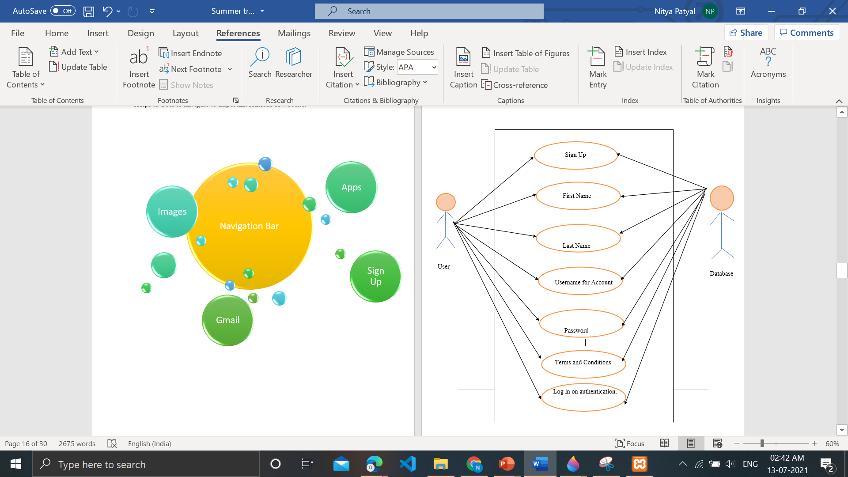
The information be stored at the admin side in database in a tabular format.

Slide 13
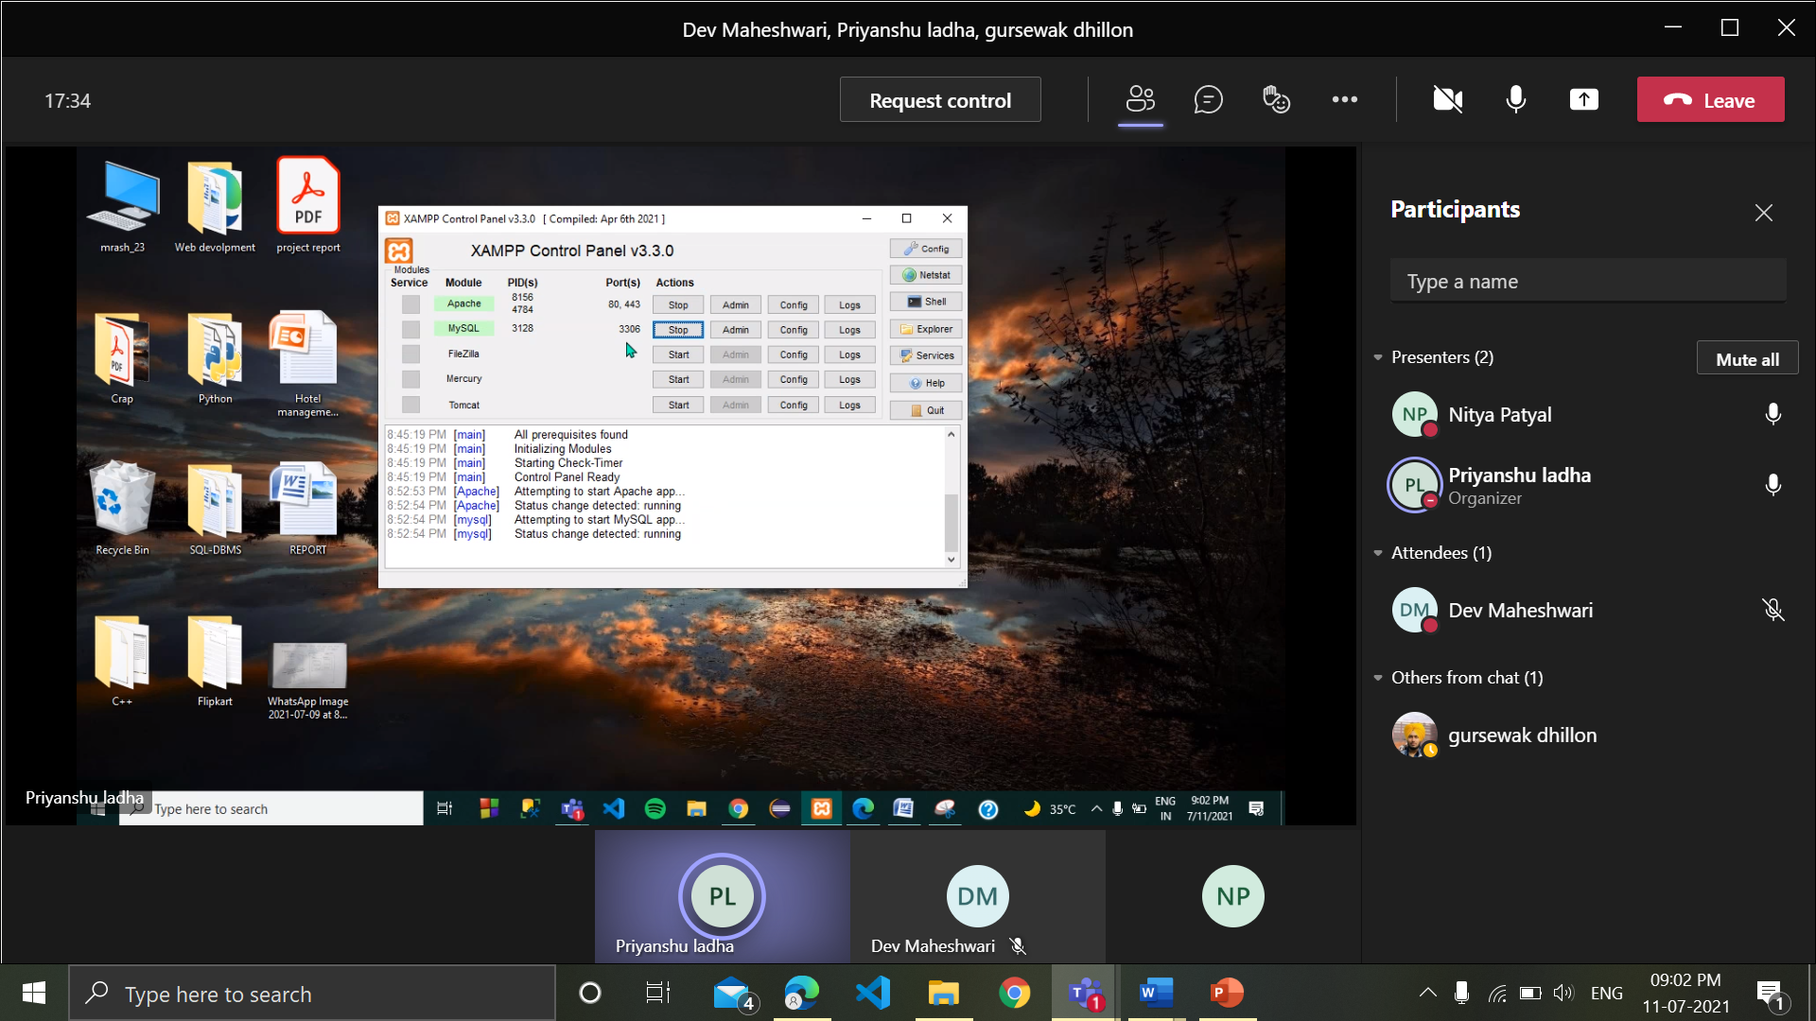
Using XAMPP Application for connecting database to web page & Apache as an interface between web page and MySQL

Slide 14
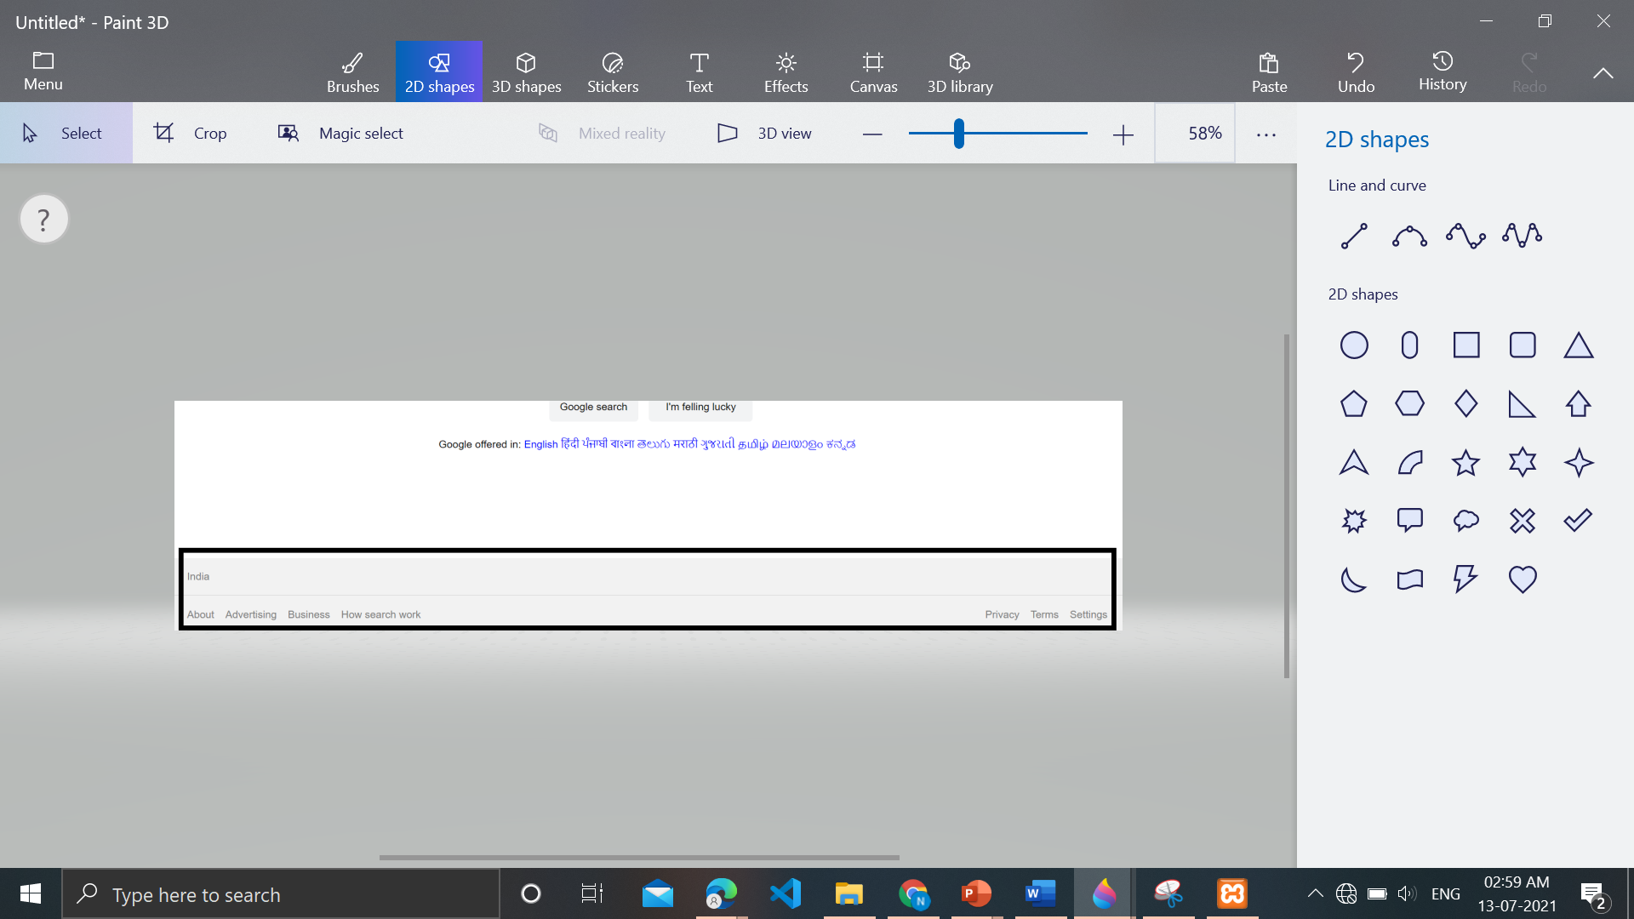
04 Footer
Footer
About
Advertising
Business
How Search works
Privacy
Terms
Setting
To help User find settings, Terms and conditions, and other related quick links to contact

Slide 15
Conclusion
Our project is only a humble venture to satisfy the needs to manage the project work. Several user-friendly coding has also been adopted. The objective of the software planning is to provide a framework with a limited project completion time frame at the beginning of the project and should be updated on a regular basis.
We expect to broaden the website and if possible, edit the necessary to make it helpful for a company or organisation and help to increase their franchise. A predictable outcome should be to take this website as a steppingstone and build from here on to a chain of innovative websites which hold potential for people interested in them.

Slide 16
Future Scope
Give clear-cut information about your business including a location map, directions, phone numbers, and email addresses.
Create a backup mechanism for backing up data and information.
Receive resumes for job seekers and pre-qualify them through an Applicant Tracking System or ATS
Provide social proof via testimonials and customer reviews.

Slide 17
Improvements:
Using Node.js for connecting with MySQL we can improve time lag occurring while submitting information in database and performing queries as it uses asynchronous.
Node.js runs single-threaded, non-blocking, asynchronously programming, which is very memory efficient.
Using Chatbots to show selective and useful searches relating to clients conditions.

Slide 18
People Involved
Gursewak Singh 20BCS9619
Priyanshu Ladha 20BCS9604
Nitya Patyal 20BCS9589
Dev Maheshwari
20BCS9620

Slide 19
Thank You
DEPARTMENT OF COMPUTER SCIENCE & ENGINEERING CHANDIGARH UNIVERSITY GHARUAN, MOHALI

